Slide 1
PALS
Estate Agency Management System

Slide 2

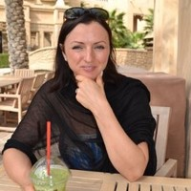
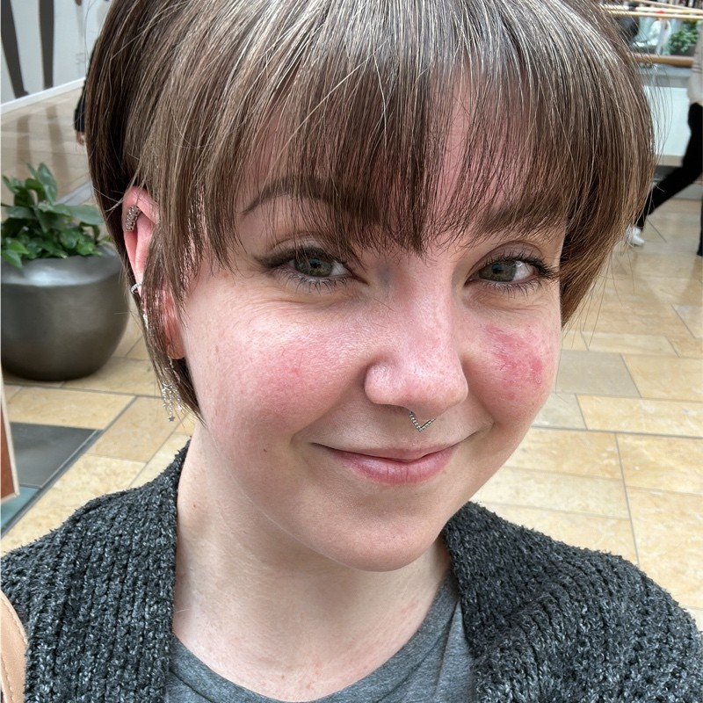
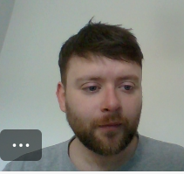
PALs
PRAVEEN KARNAM​
LORNA GORDON SMITH​
SUZY BROWN
ANDREW RENNIE
LBG: Software Engineer
LBG: Software Engineer
LBG: Software Engineer
LBG: Software Engineer

Slide 3
Project THREE
Project Three built upon what we created in Project One. We replaced our JSON server with a Spring back-end with full persistent CRUD capability.
We’ve now created a full product with end-to-end capability that can be presented to industry.

Slide 4
Project THREE: Breaking it down
FULL SPRING BACK-END
Entities, DTOs, Controllers and Services all written in Java using the Spring library.
DATA PERSISTANCE
We’re connected with a MySQL server hosting databases built by our Spring application. This has full CRUD ability to ensure that the data we add, remove or update stays added, removed or updated.
INTEGRATION WITH REACT
Merge the React application previously built in Project One together with the new Back-End we created in Project Three.
MOCK TESTING
% coverage of testing to emulate industry requirements.

Slide 5
Our approach
PLAN
Planned out our approach in the first day, writing up a brief overview of what we expected to achieve day-by-day. We updated our JIRA tickets and prioritised based on technical ordering.
Build out the back-end
We created an Entity Relationship Diagram to help visualise the relationships between the entities we were working with. We split out work on the Back-End into three main portions: Booking, Property and Buyer/Seller.
integration
Marry the React front-end from Project One up with the new Back-End application. We researched this heavily to understand what we needed to do to achieve this.
testing
Integration Testing and other applicable industry metrics. We took two different approaches here: we tested MySQL and also worked with .sql files in Spring.

Slide 6
How did we do it?
COMMUNICATION
JIRA
We held daily Stand-Ups and ad-hoc calls to tackle each item on our plan as a united team.
Keeping in touch throughout each day helped us to know we were all on track.
We updated our existing JIRA board from Project One to include items from Project Three as well and this is the rough list we worked from.
GITHUB STRATEGY
RESEARCH AND TEST & LEARN
Worked from branches – regular merges . Felt easier thanks to the extra practice
Something about research here

Slide 7
THINGS WE DID IN PROJECT ONE THAT WE BROUGHT FORWARDS
PAIRED PROGRAMMING
Having an extra pair of eyes was hugely helpful – we found this really benefitted the team as a whole.
Daily CALLS
Daily Stand-Ups to kep
KEEP IT AGILE
By continuing to work agile we were able to chip away at our list in order of priority and get everything – and more – done.

Slide 8
New Learning Points

Slide 9
Breakdown of work and learning points

Slide 10
Suzy
Back-end
Front-end
Code optimisation
Property Entity, DTO, Controller, Service
OneToMany Mapping for Property & Seller and Booking & Buyer
Linking a Property to a Booking and linking a Seller to a Property in the Database
Merge endpoints across most of the React app
Matching field names between React & Spring
Pulling data through from Spring into the relevant fields in React
Updating Fetch requests across Add Property, Update Property, Add Booking & Cancel Booking
Troubleshooting & Bug-Fixing
Streamline fetch requests to be carried out by the parent page
Split out Modals into individual React components in line with best practice
Make better use of component props to cut down unnecessary re-rendering

Slide 11
Main Challenges
NAMING CONVENTIONS
Not following industry-standard naming conventions in Project One and Project Two meant that I had to go through a lot of code with a really fine tooth-comb to figure out what was called what.
“WORKING CODE” git commits
There were times when it felt like fixing one thing broke three other things – e.g. mapping the AllBookings component to the Booking info from the database. I actually wrote that three times because I kept getting so far and not committing to git incrementally. This meant that I had no point to roll back to except losing hours of work multiple times.
hhhhhhhhhh

Slide 12
lorna
BACK-END
FRONT-END
Set up the Booking Entity, DTO, Controller and Service
Identify and resolve bugs in the React application, such as the Edit Property button not picking up the correct property ID value.
TESTING
Mock tests written and successful for Booking: New

Slide 13
Main Challenges
DATES

Slide 14
Praveen
BUYERS/SELLERS
PROPERTY SEARCH FILTER
Moved the logic for this from the Front-End to the Back-End to reduce the amount of data retrieved from the database and optimise network traffic.
MOCKMVC TESTING
Buyer: GetbyID, Add, GetbyName, Update.
Seller: GetbyID, Add, GetbyName, Update.
Property: GetbyID, Add, Update, FilterSearch.
FONT OF KNOWLEDGE

Slide 15
MAIN CHALLENGES

Slide 16
KEY LEARNING POINTS
Splitting out the back-end work
Each of us working on part of the back-end gave us the opportunity to learn the Spring side but we found we were waiting on each other’s work to be able to continue. We’d maybe take a different approach in industry to avoid the frustration we experienced here.
H
H
IF IT DOESN’T WORK…
… call Jordan. Just the threat of calling Jordan makes all bugs go away miraculously.

Slide 17
DEMO
Front-end functionality
This is visually the same as Project One, so we’ll give you a quick run-through of the functionality that we built into our site initially.
Back-end and database
We’ll give you a quick show of our codebase in Spring and show you where the data in our database is actually stored.
Q&A
We’ll have time for questions so please ask away!

Slide 18
Thank you!
We worked super hard on this slide deck hahahaha

